Slide 1


System Voltage and Frequency Regulation Shipboard Power System Fundamentals Revision of 3 February 2026
Dr. Norbert Doerry
http://doerry.org/norbert/MarineElectricalPowerSystems/index.htm
© 2026 by Norbert Doerry This work is licensed via: CC BY 4.0 (https://creativecommons.org/)

Slide 2
Essential Questions
What hardware and software implement voltage and frequency regulation? | Understand
How does a PID controller work and how is it applied to voltage and frequency regulation? | Understand
What is droop and why is it used? | Understand
What are the differences between rotating machines and power electronic converters with respect to system voltage and frequency regulation? | Understand

Slide 3
Introduction
One of the goals of power system design is ensuring the voltage and frequency remain within interface standard limits
IEEE Std. 45.1 ac voltage tolerance: +6% and -10%
IEEE Std. 45.1 ac frequency tolerance: ±5%
IEEE Std. 45.1 dc voltage range: ±4% (setpoint adjustable)
IEEE Std. 45.1 dc voltage tolerance: ±1.5%
Regulating voltage and frequency depends on …
Whether the interface to the power system is the output of a synchronous generator or a power electronic converter.
Whether there is only one source of power on the system, or multiple sources of power on the system.
The method for sharing real and reactive (for ac systems) power if there are multiple sources of power on the system.

Slide 4
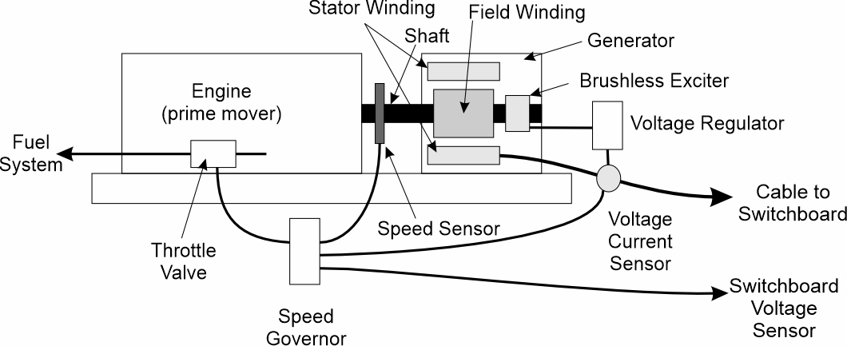
Generator sets with synchronous generators
Voltage regulator controls the field winding current.
Usually via a brushless exciter (instead of field brushes).
May include functionality to assist in paralleling generators.
Speed governor regulates shaft speed (frequency) by controlling the fuel throttle valve.
May include functionality to match frequency and phase for paralleling generators.
If output of generator set immediately rectified for dc operation …
Control algorithms determine the voltage and speed (frequency) set points for regulation.
If paralleled to other ac sources …
Voltage reference modified to enable sharing of reactive power.
Shaft speed reference modified to enable sharing of real power.

Slide 5
Power electronic converters
Grid-forming
Control algorithms determine the magnitude and frequency (for ac) of the voltage output.
May include functionality to enable parallel operation with multiple grid-forming power electronic converters and synchronous generators.
Grid-following
Control algorithms determine the magnitude, frequency (if ac) and phase (if ac) of the voltage at the interface and create a current waveform to produce the desired amount of power.
May include functionality for sharing real and reactive (for ac) power with other sources.
Requires at least one grid-forming converter or synchronous generator to be paralleled to it; a converter detects loss of voltage reference:
It may shut down, or
It may switch to a grid-forming control algorithm.

Slide 6
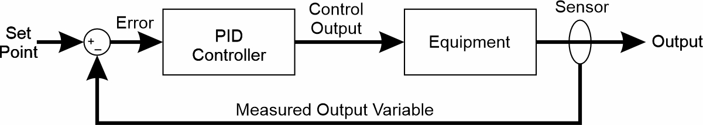
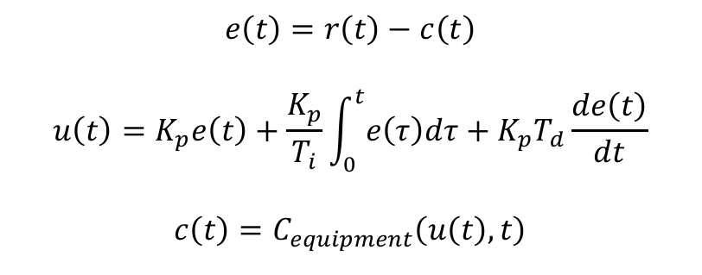
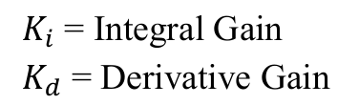
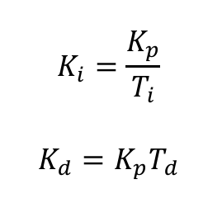
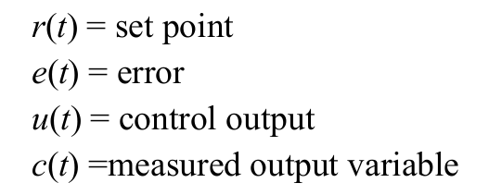
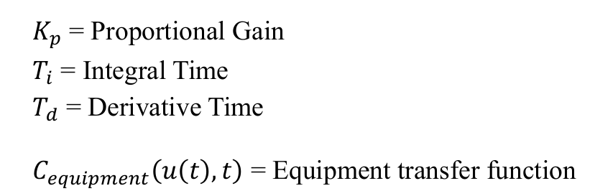
PID Controller
PID controllers often used to implement voltage regulators and speed governors.
Alternate Definition

Slide 7
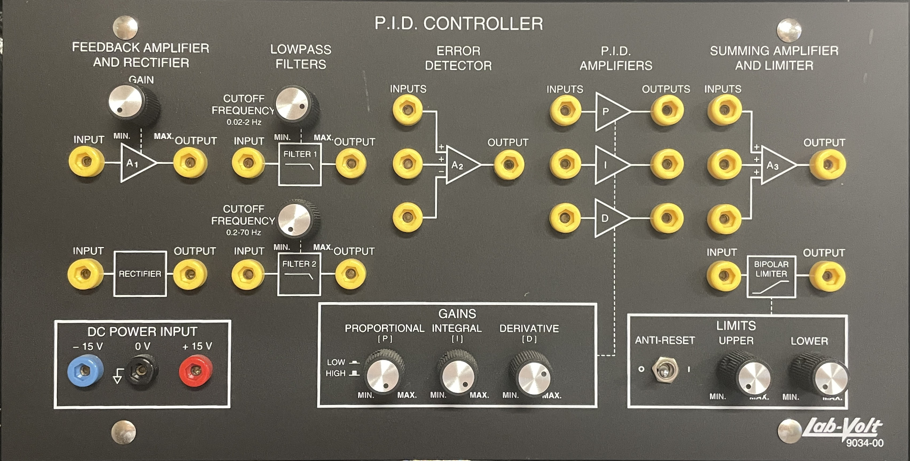
Lab-Volt PID Controller

Slide 8
PID Controller Tuning
Many techniques for choosing PID parameters K_{p}, T_{i}, K_{i}, T_{d}, and K_{d}
Often empirical methods are used.
For many controllers, T_{d} and K_{d} are set to 0, largely due to stability concerns.
Can add additional signals to error summation.
Ziegler-Nichols method for PID tuning (empirical method)
K_{i} and K_{d} gains initially set to zero
K_{p} is increased until the ultimate gain K_{u} at which the output of the loop starts to oscillate constantly
T_{u} is the oscillation period (s).
For P controller: K_{p} = 0.5 K_{u}
For PI controller: K_{p} = 0.45 K_{u} K_{i} = 0.54 K_{u} / T_{u}
For PID controller: K_{p} = 0.6 K_{u} K_{i} = 1.2 K_{u} / T_{u} K_{d} = 0.075 K_{u} T_{u}

Slide 9
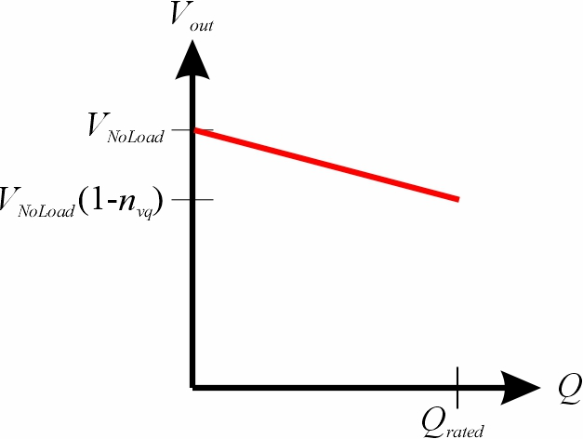
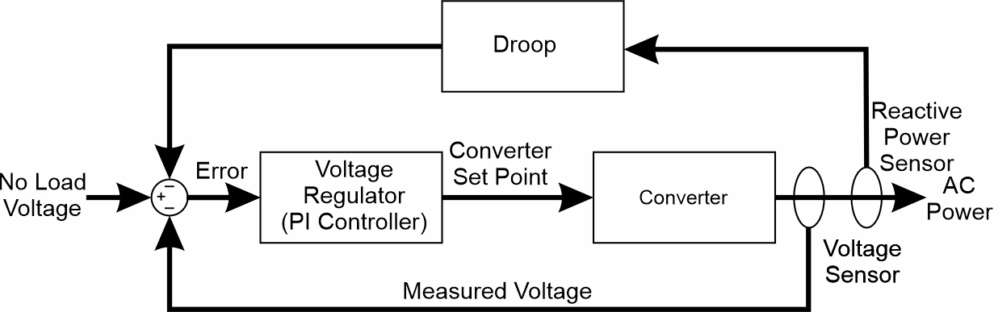
Droop
Droop is one way for multiple sources to operate in parallel.
AC systems:
Voltage setpoint decreases as the reactive power increases
Frequency setpoint decreases as the real power increases
DC systems:
Voltage setpoint decreases as the real power increases
Droop often implemented by adding an additional feedback signal to the error signal of a PI controller.
Voltage Droop for ac system

Slide 10
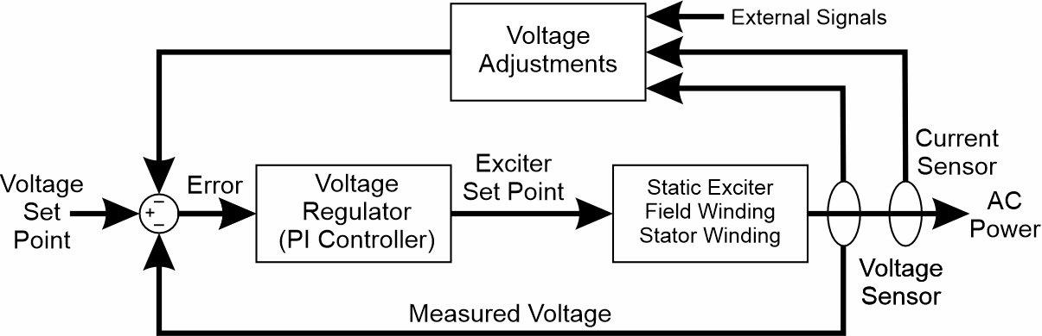
Voltage Regulation Implementation: Synchronous Generator

Slide 11
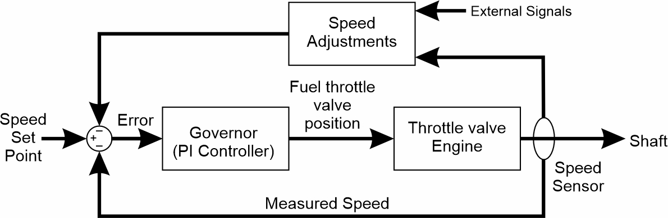
Frequency Regulation Implementation: Generator set prime mover

